Slide 1
Importing Securing Data In Service Now
SlideMake.com

Slide 2

Introduction to Importing Securing Data in ServiceNow
Importing data securely is essential to maintain the integrity and confidentiality of information within ServiceNow.
Proper import procedures ensure compliance with organizational security policies and data privacy standards.
This presentation covers best practices and methods for securely importing data into ServiceNow.
Notes:
Image source: https://learning.servicenow.com

Slide 3

Types of Data Import in ServiceNow
ServiceNow supports various data import options including Import Sets, Data Sources, and IntegrationHub.
Each method offers different levels of control, automation, and security features.
Understanding these options helps select the most appropriate method for secure data handling.
Notes:
Image source: https://www.servicenow.com

Slide 4

Preparing Data for Secure Import
Data should be cleansed and validated before import to prevent security risks such as injection attacks.
Sensitive information must be encrypted or masked during transfer and storage.
Proper data mapping and transformation ensure accurate and secure data integration.
Notes:
Image source: https://www.servicenow.com

Slide 5

Configuring Import Sets for Security
Import Sets allow for staging data before it is inserted into production tables, enabling review and validation.
Access controls should be configured to restrict who can create, run, or modify import jobs.
Use transform maps carefully to enforce data integrity and security policies during import.
Notes:
Image source: https://www.slidemake.com

Slide 6
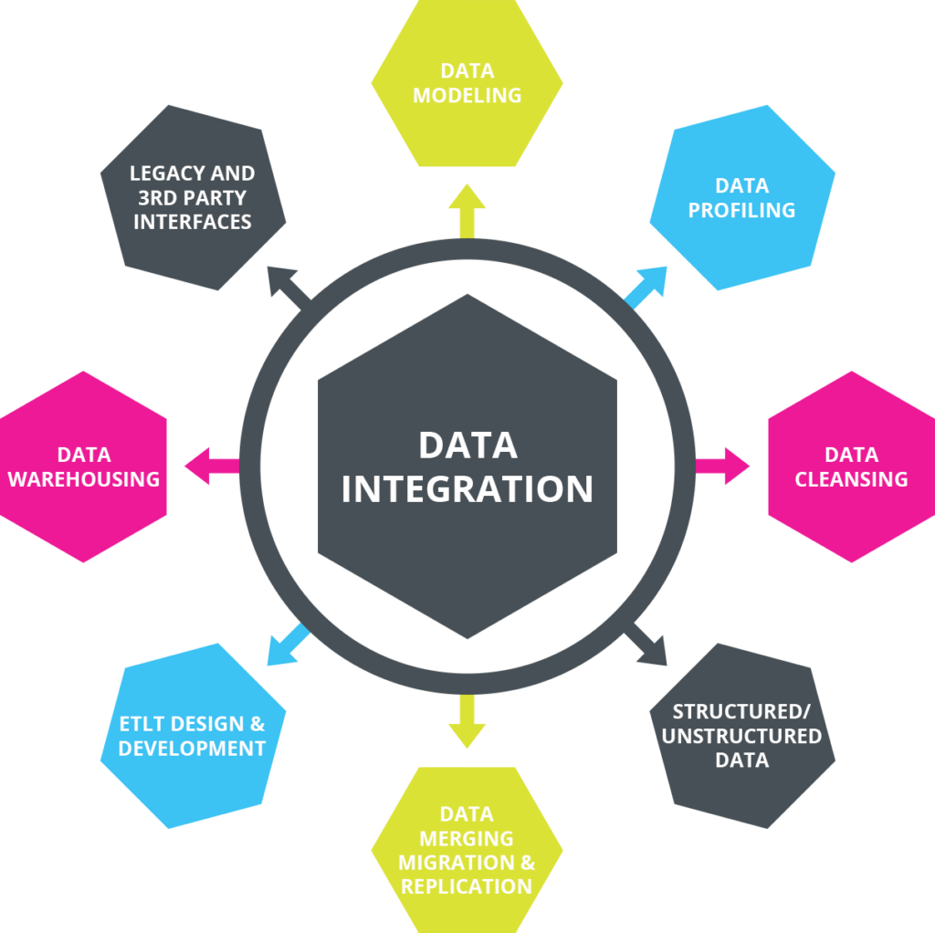
Using Data Sources for Secure Integration
Data Sources facilitate direct connections to external secure data repositories like databases or APIs.
Authentication and encryption protocols (e.g., SSL/TLS) should be used to secure data transmission.
Regular audits and monitoring of Data Source configurations help maintain ongoing security.
Notes:
Image source: https://datawarehouseinfo.com

Slide 7
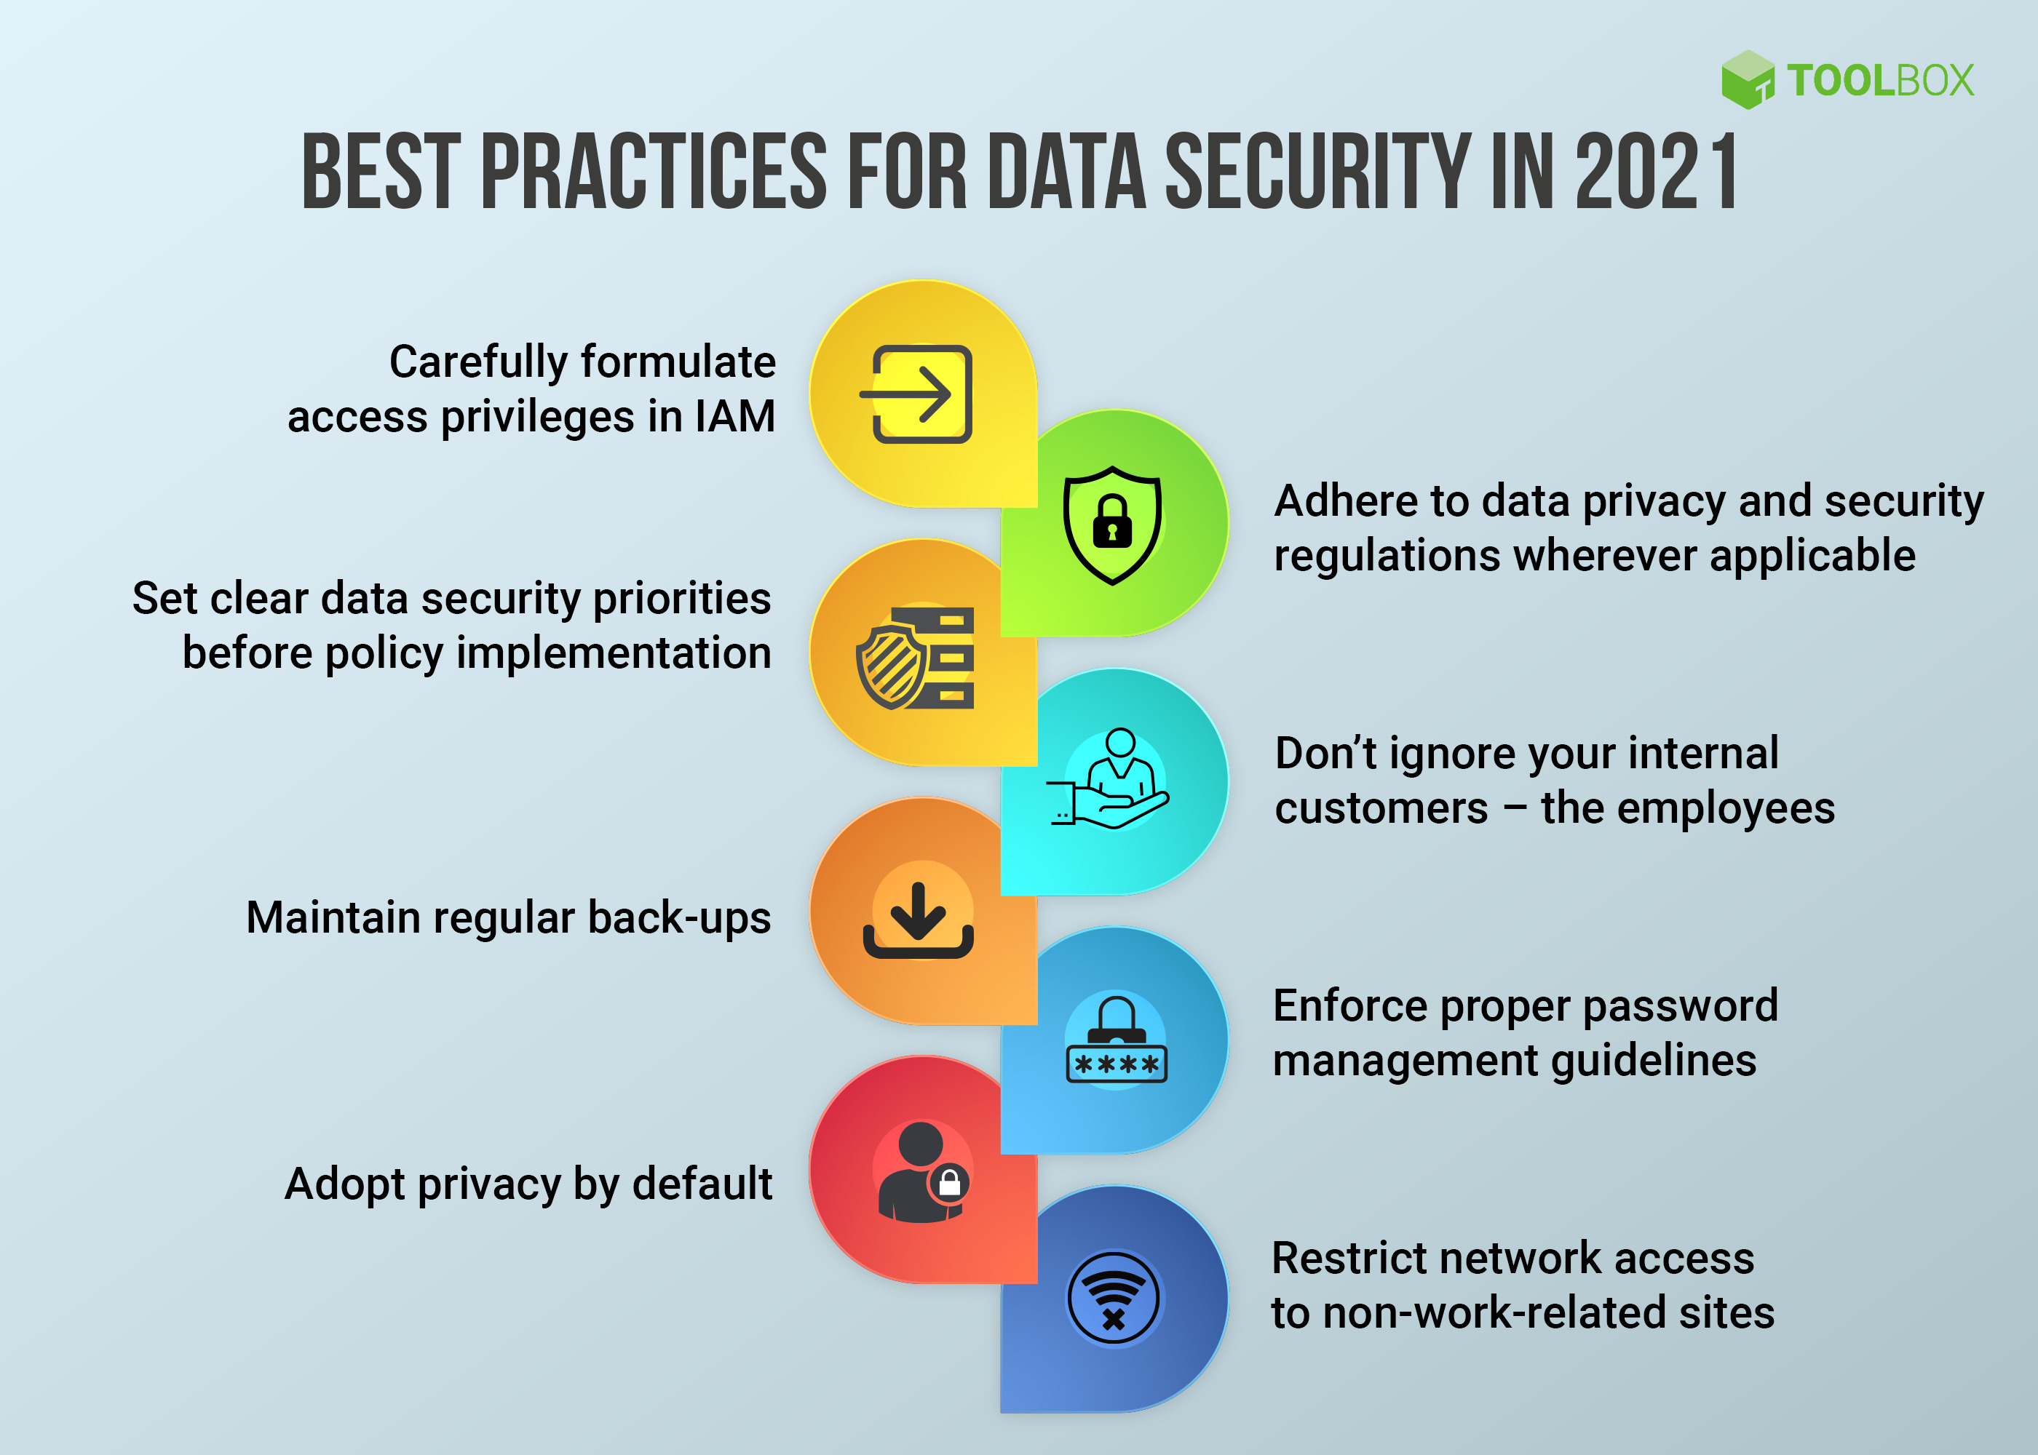
Automation and Security Best Practices
Automate imports with scheduled jobs while ensuring proper permissions are in place.
Implement role-based access control (RBAC) to limit who can perform sensitive import operations.
Maintain logs and audit trails for all import activities to detect and respond to security incidents.
Notes:
Image source: https://images.spiceworks.com

Slide 8

Validating and Verifying Imported Data
Post-import validation checks help ensure data accuracy and security compliance.
Use scripts or workflows to automatically flag or quarantine suspicious or inconsistent data.
Regularly review import logs and audit reports to identify potential security issues.
Notes:
Image source: https://jdocs.com

Slide 9
References
ServiceNow Documentation – Importing Data Securely.
Best Practices for Data Security in ServiceNow.
Organizational Security Policies and Compliance Guidelines.

